Slide 1
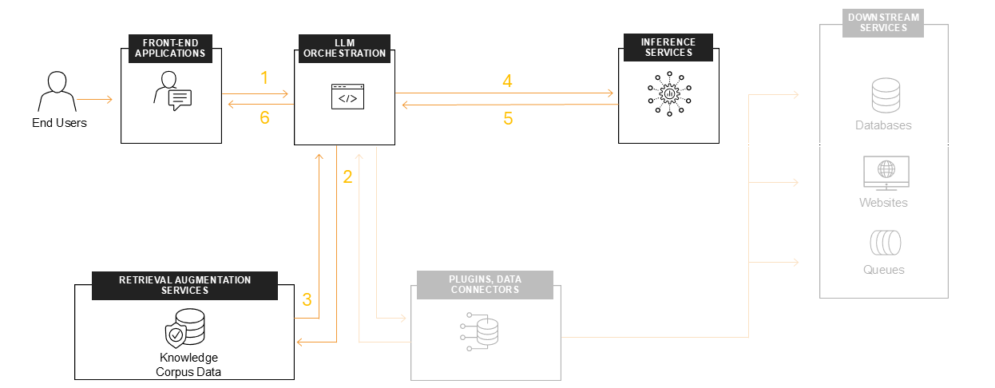
HELLOVESTER: AI-POWERED CRYPTOCURRENCY ANALYTICS
Malak Parmar | Nikhil Doye

Slide 2
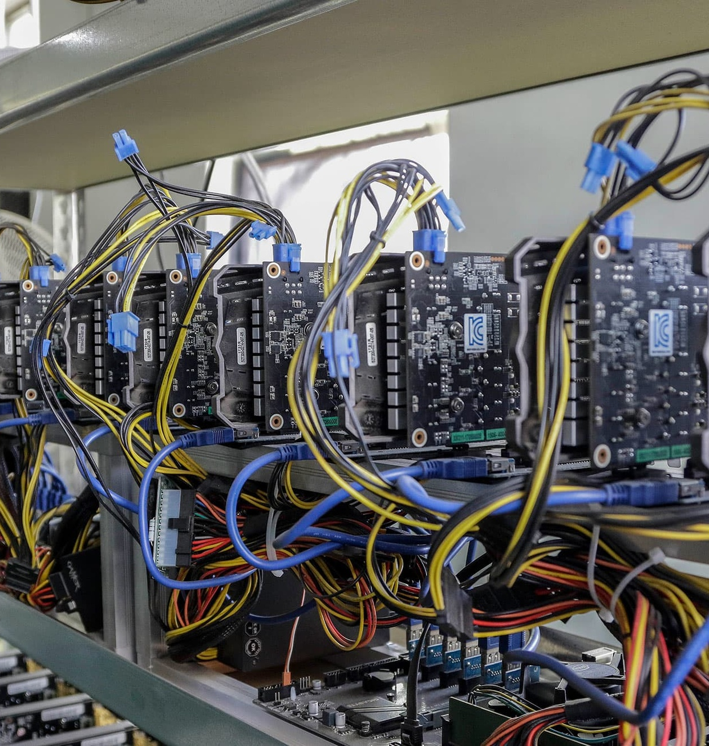
HELLOVESTER APPLICATION: AI-POWERED CRYPTOCURRENCY ANALYTICS
HelloVester is an innovative AI-powered cryptocurrency analytics tool that combines retrieval-augmented generation with temporal analysis. Bettervester empowers users to unlock invaluable insights from the complex and fragmented crypto market by integrating advanced data processing, machine learning, and visualization techniques.

Slide 3


PROBLEM STATEMENT
Users struggle to find accurate, structured, and up-to-date crypto insights
Complex investment mechanisms require stepwise explanations
Existing solutions lack multi-modal responses (text & diagrams)
Cryptocurrency information is often scattered, outdated, and lacks a cohesive structure, making it challenging for users to access reliable and comprehensive insights.
Many cryptocurrency investment strategies and trading techniques are complex, requiring step-by-step guidance and explanations to help users understand the processes involved.
Current cryptocurrency education and research platforms often provide information in a single format, such as text-based articles, without offering alternative modes of learning like interactive diagrams or flowcharts.
HelloVester aims to address these key challenges by providing a multi-agent AI chatbot that delivers accurate, structured, and up-to-date cryptocurrency insights through both text-based responses and flowchart-based explanations, empowering users to learn and make informed decisions more effectively.

Slide 4
KEY CHALLENGES IN CRYPTO ANALYTICS
Data Fragmentation
Temporal Pattern Recognition
Crypto data is scattered across multiple time periods and assets, making it challenging to obtain a comprehensive view.
The complexity of identifying meaningful temporal patterns in crypto markets requires advanced analytical capabilities.
AI Hallucinations
High Latency
AI-generated financial insights can sometimes be inaccurate or hallucinated, leading to unreliable decision-making.
Querying large historical crypto datasets can be time-consuming, causing delays in market analysis.

Slide 5
KEY FEATURES
Flowchart-based Responses
Provides step-by-step visualizations to improve clarity and understanding of complex crypto-related concepts.
Real-time Query Analysis
Detects whether a user query is seeking a direct answer or requires a stepwise explanation, and responds accordingly.
RAG for Cryptocurrency Knowledge
Utilizes Retrieval-Augmented Generation (RAG) to leverage knowledge embeddings for accurate and context-aware responses.
Efficient FastAPI Backend
Provides a fast and scalable API layer to handle user queries and interact with the underlying components.

Slide 6



SOLUTION OVERVIEW
Domain-Specific Response Generation
Custom Performance Scoring
RAG System Architecture
Hybrid Search
Temporal-Aware Retrieval
The HelloVester system architecture features a hybrid search approach that combines vector-based retrieval and metadata-based filtering to efficiently surface relevant cryptocurrency data. It also incorporates temporal-aware retrieval to account for the time-series nature of crypto assets, and domain-specific response generation to provide tailored insights.
HelloVester utilizes a hybrid search approach that leverages both vector embeddings and metadata filters to retrieve the most relevant data from the underlying database. This allows for more precise and comprehensive querying compared to traditional search methods.
The system is designed to be aware of the temporal aspect of cryptocurrency data, enabling users to query and analyze trends across different time periods, such as hourly, daily, or weekly.
HelloVester's AI core is trained on domain-specific prompts and language models to generate cryptocurrency-focused insights and analyses, ensuring the output is tailored to the needs of crypto investors and analysts.
The system introduces a custom performance scoring metric that combines various market factors, such as price change percentage and trading volume, to provide a more holistic and informative assessment of cryptocurrency performance.

Slide 7








TECHNICAL ARCHITECTURE
Data Layer
AI Core
Frontend
Processing

Slide 8


EVALUATION METRICS
Category
Metrics
Current Performance
Retrieval
Precision@5
82%
Retrieval
MRR
0.91
Generation
ROUGE-L
0.76
Generation
Hallucination Rate
4%
Operational
Latency
1.8s
Operational
Cost/Token
$0.003
*The performance metrics presented in this slide are based on internal testing and evaluation of the HelloVester system.

Slide 9

CHALLENGES & SOLUTIONS
Crypto analytics faces data fragmentation and volatility challenges. HelloVester addresses these through timestamp-based queries, domain-specific prompts, and volatility-adjusted performance scoring, ensuring accurate insights into the dynamic cryptocurrency markets.

Slide 10
FUTURE ROADMAP
Q2 2025
2026
Real-time market data integration, Portfolio simulation engine
Regulatory compliance module, Institutional-grade API
Q3 2025
Predictive analytics (LSTM + Prophet), Multi-chain NFT analysis

Slide 11
CASE STUDY - MARCH 2025 ANALYSIS
Query
Process
Identify top 5 performers with <30% volatility
Retrieved 15 candidates from 36K records, Filtered using volatility threshold, Generated comparative analysis
Outcome
Insights
0.92 precision score in top 5, 1.2s response time
Litecoin, a prominent low-risk cryptocurrency, witnessed a significant surge in March 2025, outperforming many top-tier digital assets with its remarkably low volatility

Slide 12
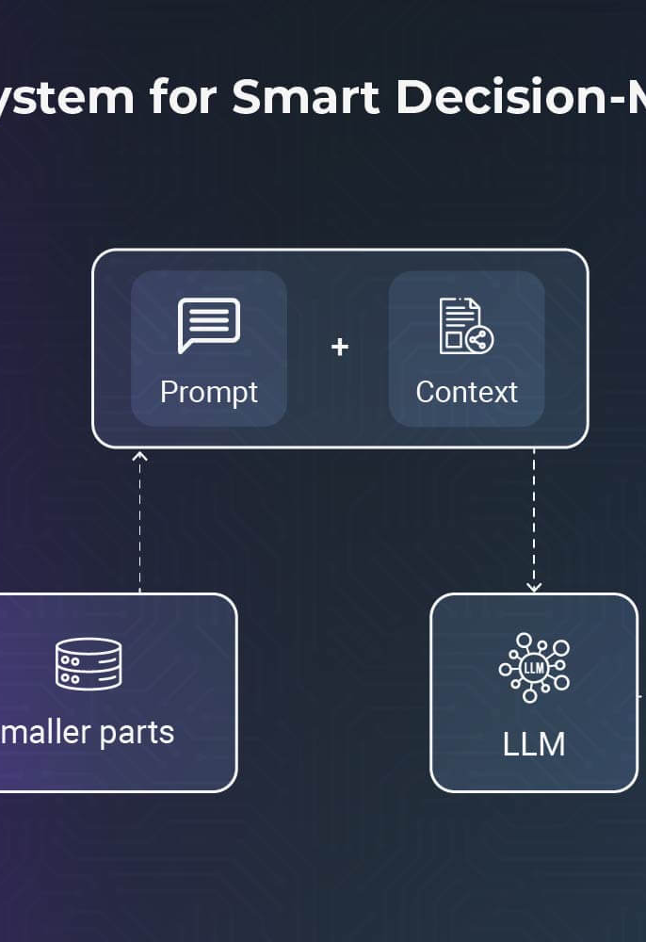
IMPACT & APPLICATIONS
HelloVester's AI-powered cryptocurrency analytics platform has far-reaching applications that can benefit a wide range of users. By providing faster market analysis and more accurate trend prediction, BetterVester empowers hedge fund managers to optimize their crypto portfolios, enabling them to make better-informed investment decisions. Additionally, the tool's ability to generate regulatory audit trails and fact-check crypto-related journalism can greatly assist compliance teams and crypto media outlets in upholding transparency and accuracy.

Slide 13
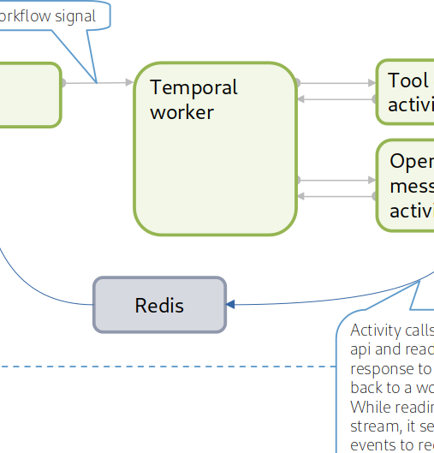
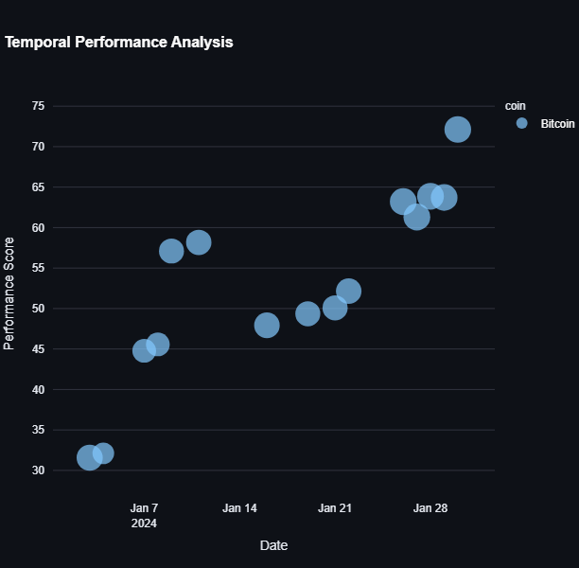
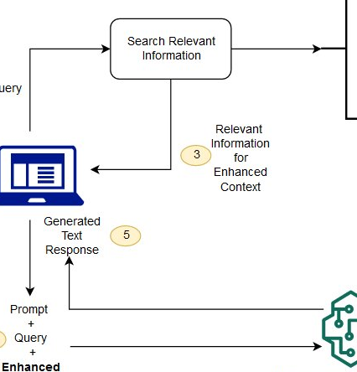
LIVE DEMO
Temporal Query Input
Interactive Chart Exploration
AI-Generated Analysis
Showcasing the ability to input temporal queries, such as 'Show coins with >5% gain and $1B+ volume in March 2025'.
Enabling users to interactively explore and visualize the crypto market data and trends through dynamic charts and graphs.
Demonstrating the generation of in-depth market analysis and insights based on the retrieved data, powered by the HelloVester system.

Slide 14


Q&A
Handling emerging crypto assets
Model update strategies
Discuss strategies for integrating and analyzing new cryptocurrency assets as they emerge in the market.
Discuss techniques for regularly updating the AI models to account for changes in market dynamics and user feedback.

